Slide 1
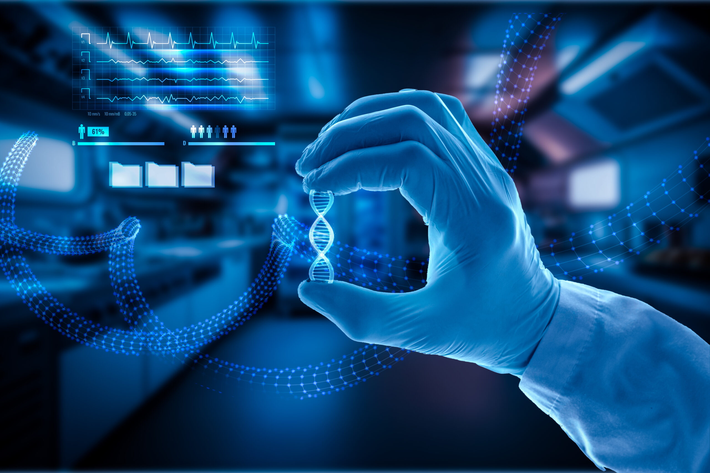
NANO TECHNOLOGY

Slide 2
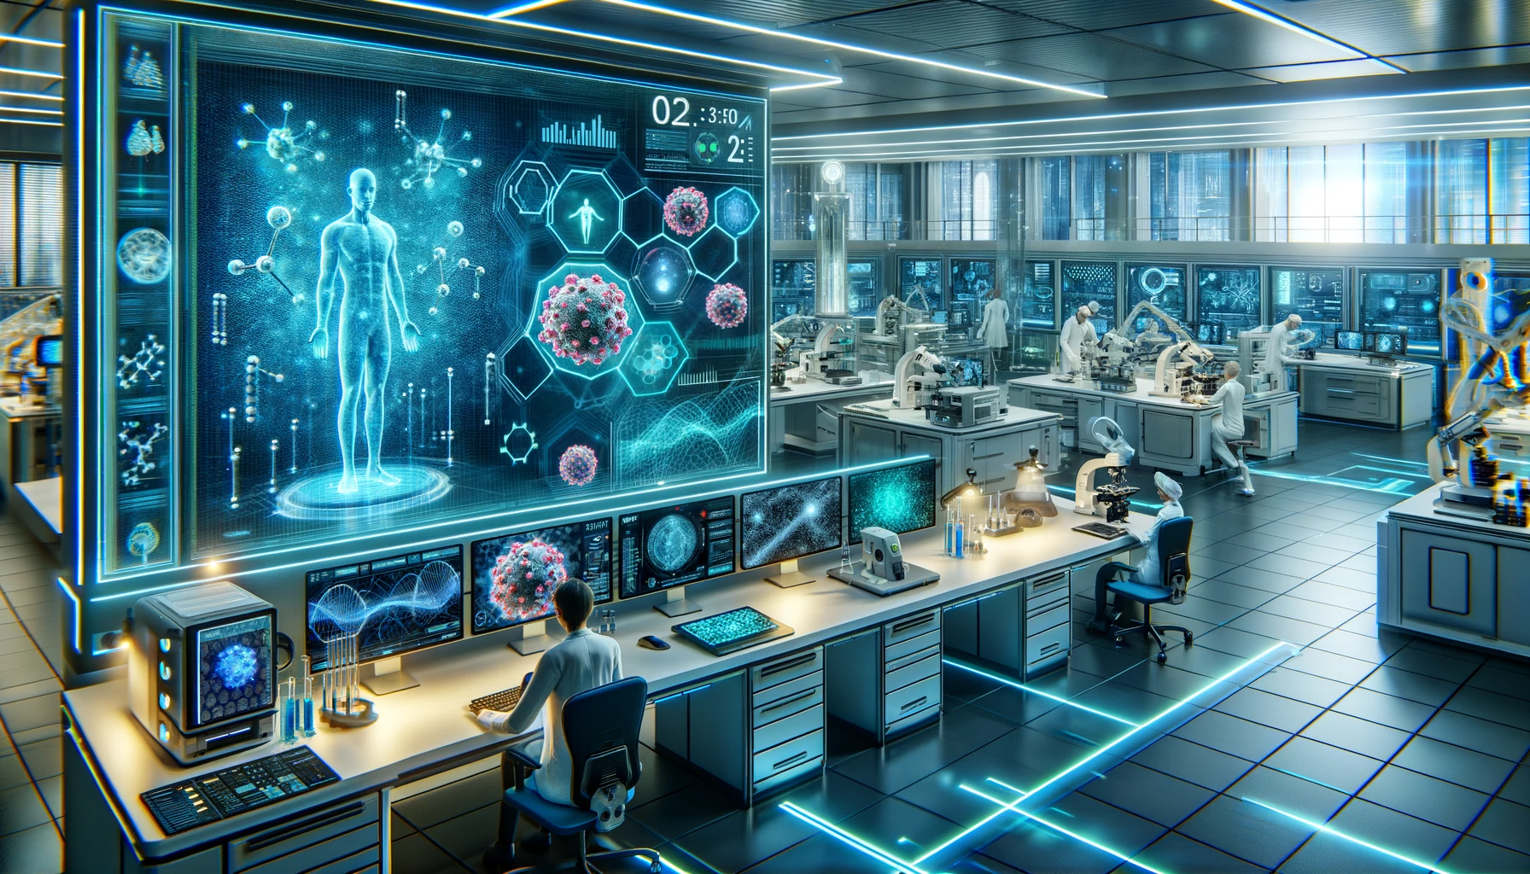
Present by:
Mr.MANOJ RAJ
Mr.MOHANRAJ
Mr.NANDHA KUMAR
Mr.VENGATESAN

Slide 3
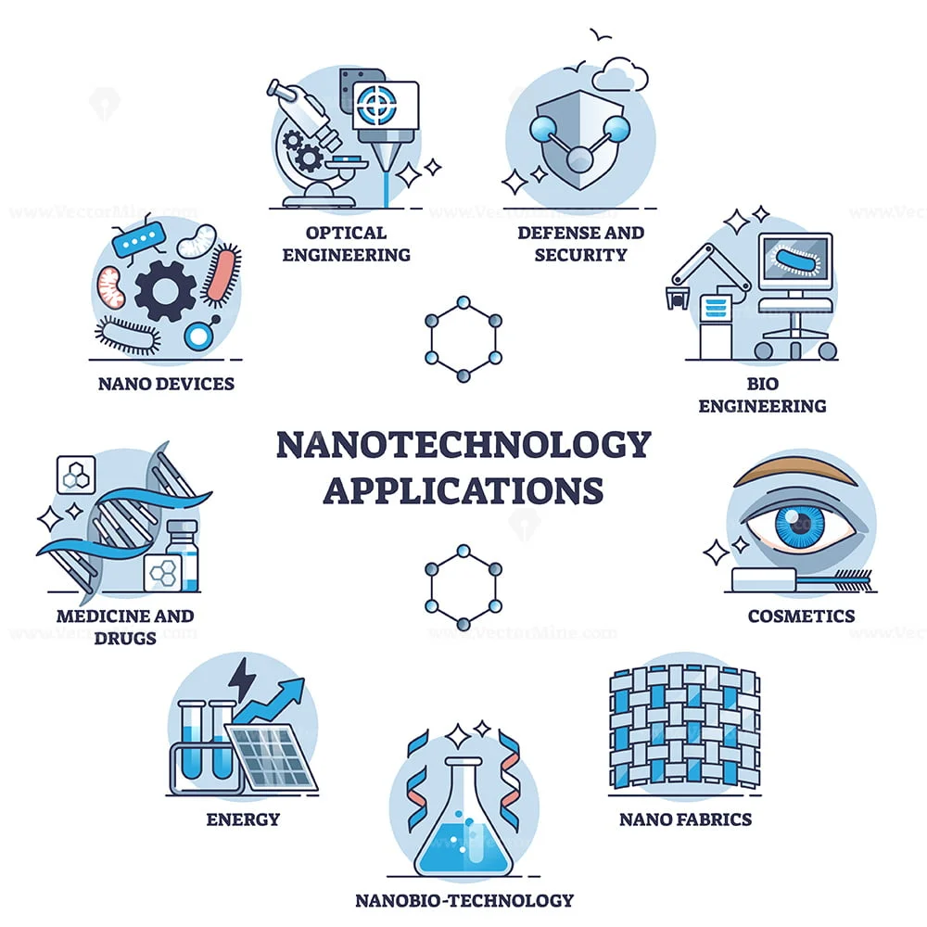
Nanotechnology :
It involves the manipulation, study, and application of materials at the nanoscale (1 to 100 nanometers). At this scale, materials exhibit unique physical, chemical, and biological properties that differ from their bulk counterparts.
Applications of Nanotechnology
* Medicine and Healthcare
* Electronics
* Aerospace and Automotive
* Quantum Computing

Slide 4
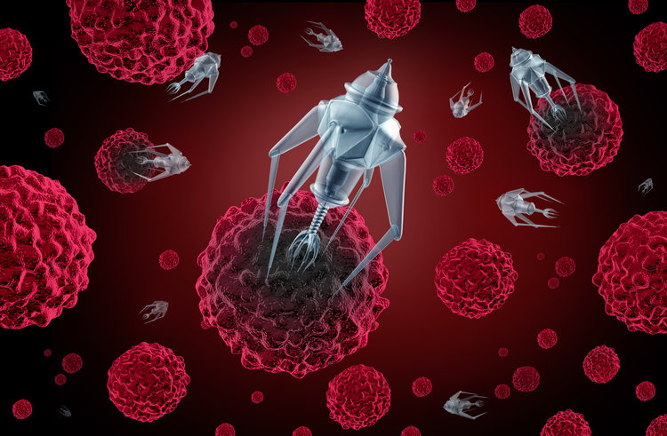
Applications of Nanotechnology in Medicine
Nanotechnology has revolutionized the medical field by enabling innovative solutions for diagnosis, treatment, and prevention of diseases.
Targeted Drug Delivery:
Nanoparticles carry drugs directly to diseased cells, minimizing harm to healthy tissues.
Nanoparticle Therapies:
Deliver chemotherapy directly to tumor cell.
Nano Robots :
It helps in the remove the block in artieris.
Performming the precious surgery in cellular level
Customers
Market gap
Few, if any, products on the market help customers like we do​
Costs
Financials
Loss of productivity costing consumers thousands of dollars
Millennials account for about a quarter of the $48 billion spent on other products in 2018​

Slide 5
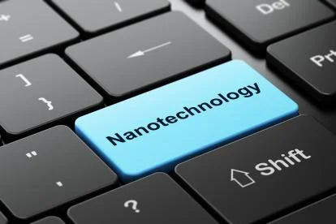




Solution
Applications of Nanotechnology in Computers and Information Technology
High-Density Data Storage:
* Used in hard drives to increase storage capacity without increasing physical size.
* Nanoscale materials enable faster and more reliable storage devices Uses nanotechnology to create high-speed memory with lower power requirements.
Artificial Intelligence (AI) Hardware:
* High-speed processors designed for AI computations.
* Nanotechnology mimics neural networks, leading to breakthroughs in AI and machine learning.
Close the gap
Target audience
Cost savings
Easy to use
Gen Z (18-25 years old)
Reduce expenses for replacement products
Simple design that gives customers the targeted information they need​

Slide 6
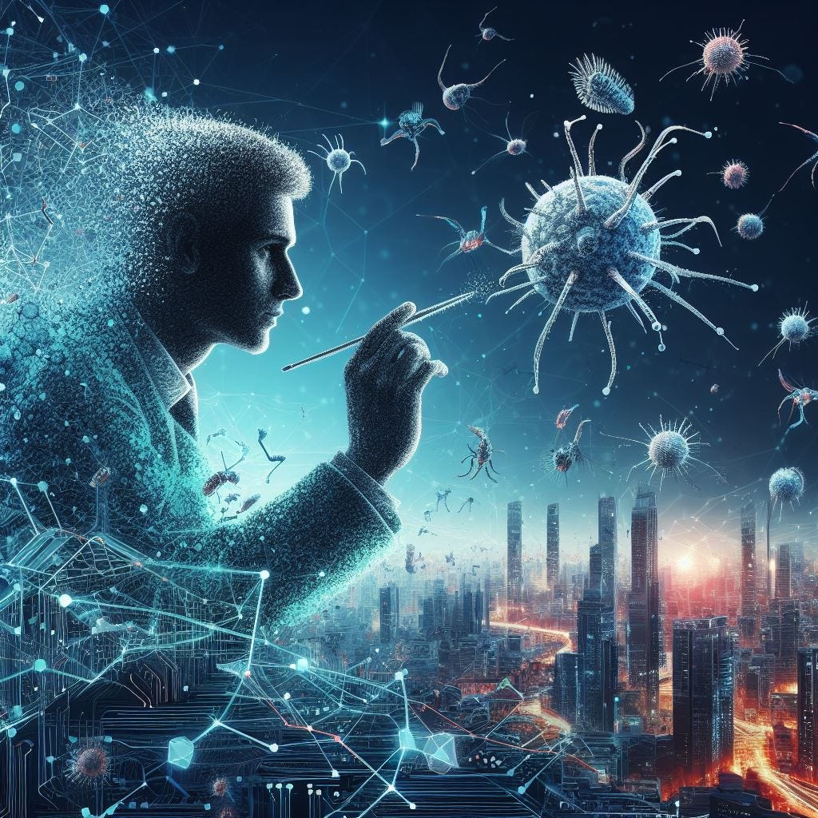



Product Overview
The Future of Nanotechnology
Medicine: Targeted drug delivery, regenerative medicine, and cancer-fighting nano robots.
Electronics: Faster quantum computing, flexible devices, and AI-driven nano chips.
Energy: Efficient solar cells, long-lasting batteries, and sustainable hydrogen production.
Environment: Nano filters for clean water, air pollution control, and carbon capture.
Agriculture: Smart nano sensors, precision fertilizers, and extended food preservation.
Aerospace: Lightweight nano materials for faster spacecraft and self-healing systems.
Unique
First to market
First beautifully designed product that's both stylish and functional​
Tested
Authentic
Conducted testing with college students in the area​
Designed with the help and input of experts in the field ​

Slide 7
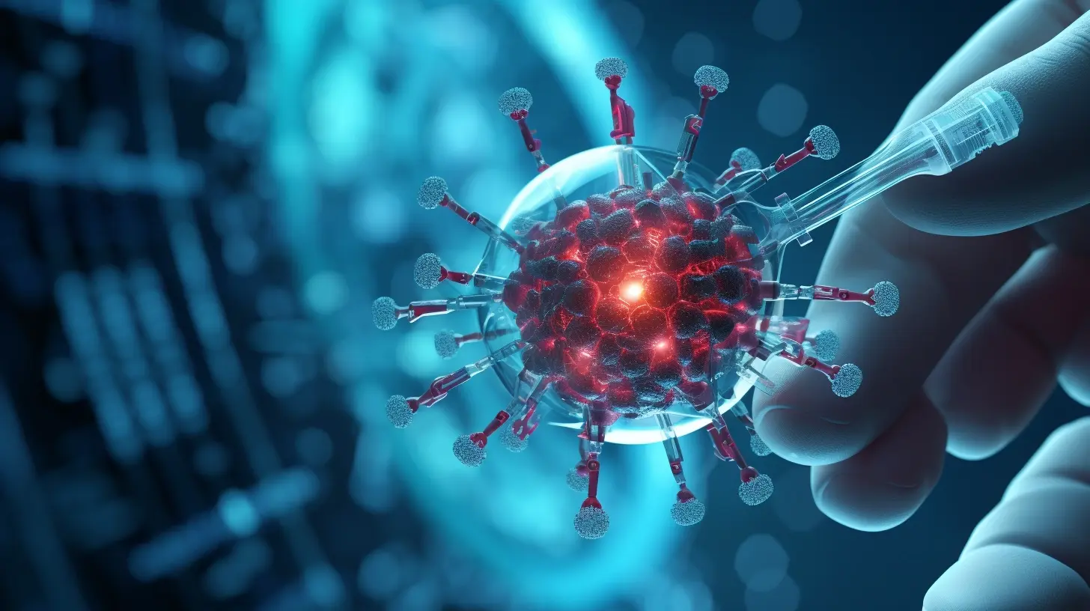
Product Benefits
THANK YOU

